Slide 1




EDA PROJECT
ANALYSIS ON MOVIE DATA
Presented by: Vibhor Rastogi

Slide 2

Introduction
Movies are a unique blend of art and entertainment that captivate audiences through compelling storytelling, powerful performances, and innovative technical achievements. In this dataset factors such as genre, director influence, star power and release timing all play crucial roles in determining a film's reception and financial performance.
This case study leverages an exploratory data analysis (EDA) of a dataset containing 1000 high-rated movies from IMDb to gain insights that can address these challenges and guide future industry strategies.
This case study aims to provide actionable insights that can help the film industry adapt to changing audience preferences, manage production challenges, and enhance the quality and appeal of future productions. The findings from this analysis will serve as a valuable resource for filmmakers, producers, and marketers striving to understand what makes a movie successful and how to leverage these insights in their projects. Through this exploration, we hope to contribute to the ongoing evolution and success of the film industry.

Slide 3

Problem Statement
How can the film industry leverage data-driven insights to overcome challenges such as
Shifting audience preferences
Varying production revenue
unpredictable box office performance
This problem statement encapsulates the core issues facing the film industry and outlines the potential of data analysis to address them. It highlights the need to understand the factors driving audience engagement, optimizing revenue, improve box office prediction, and differentiate films in a crowded market.

Slide 4
Pre-Profiling
Data Handling
Post Profiling
Below are our key observations during Pre-Profiling:
1.)There are Missing values in Metascore and Revenue
2.) There are no typos or outliers in the dataset
3.) The values of the Rating are inconsistent
4.) There is no redundant data
Genre Distribution:
The most common genres are Drama, Action, and Comedy. Less common genres include Western, Musical, and War.
Rating-Revenue Correlation:
The correlation between ratings and revenue is approximately 0.22, suggesting a moderate positive relationship; higher-rated movies tend to generate more revenue.
Runtime-Rating Relationship:
Movies with shorter runtimes (around 66 to 87 minutes) show varying average ratings, indicating that runtime alone does not strongly influence ratings.
During Data Handling we performed the following tasks:
1.)Corrected the inconsistent values of Rating
2.)Updated missing values for Metascore and Revenue

Slide 5
Exploratory Data Analysis
Below are the questions that we solved:
1.) How have audience preferences for film genres evolved over the past decade?
2.) What demographic factors correlate most strongly with box office success?
3.) How do critical reviews and audience ratings influence box office performance?
4.) Does the release year of a film have any impact on its overall box office performance?
5.) Does the combination of director and Actors affect the box office performance?
6.) Does the length of the movie have any impact on its rating or votes?
7.) What is the impact of movie ratings on revenue?
8.) What factors most influence movie success?

Slide 6
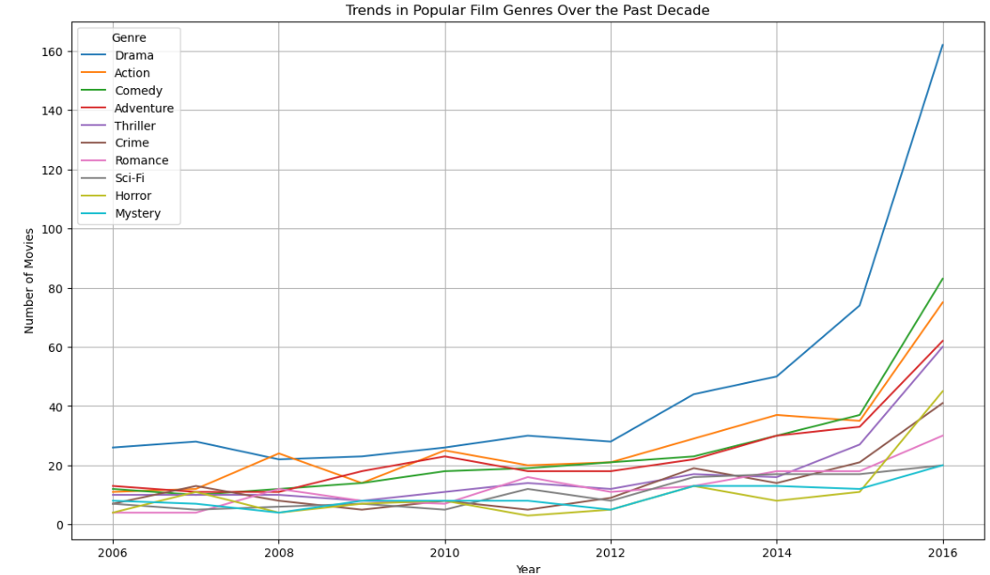
Q1:How have audience preferences for film genres evolved over the past decade?

Slide 7
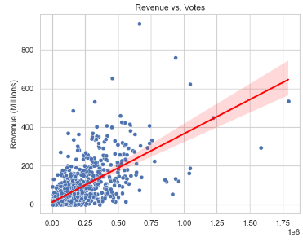
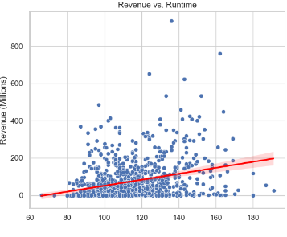
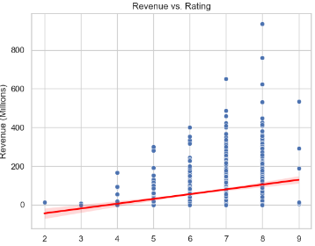
Q2)What demographic factors correlate most strongly with box office success?

Slide 8
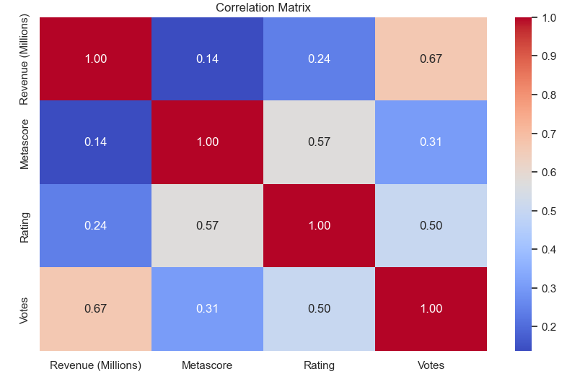
Q3) How do critical reviews and audience ratings influence box office performance?

Slide 9
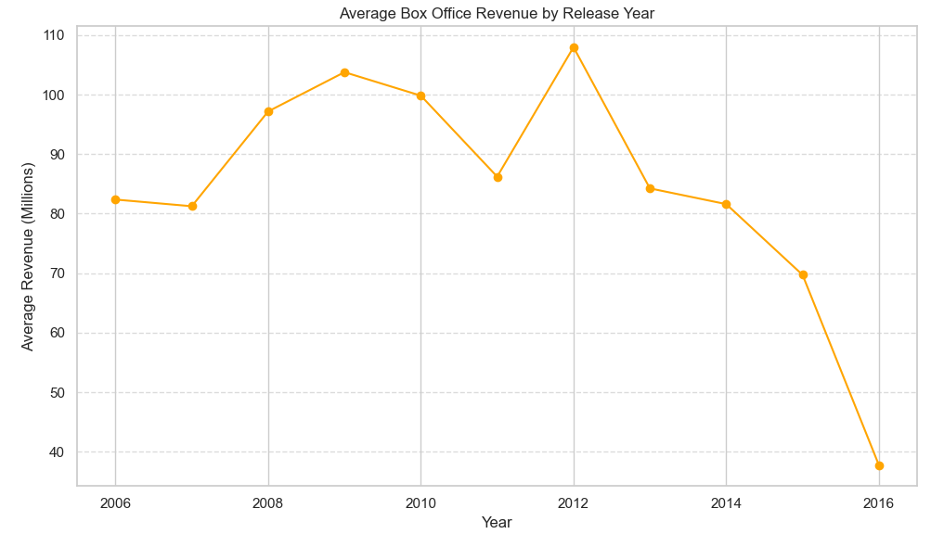
Q4) Does the release year of a film has any impact on its overall box office performance?

Slide 10
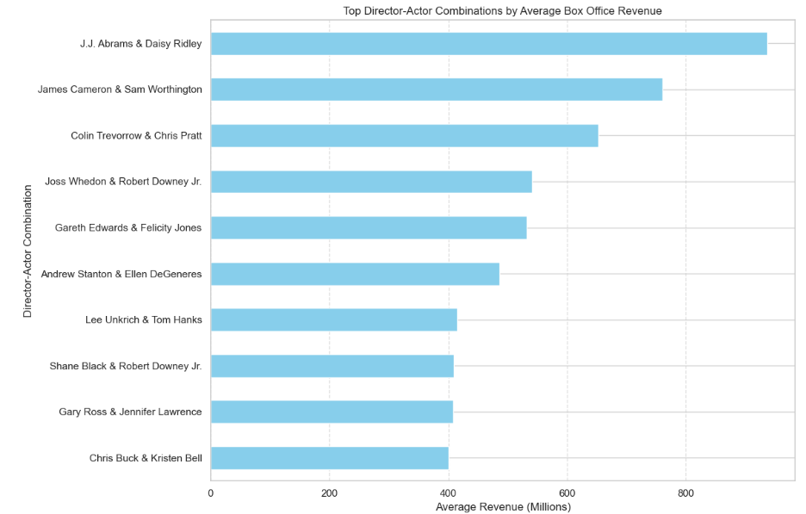
Q5) Does the combination of director and Actors affect the box office performance?

Slide 11
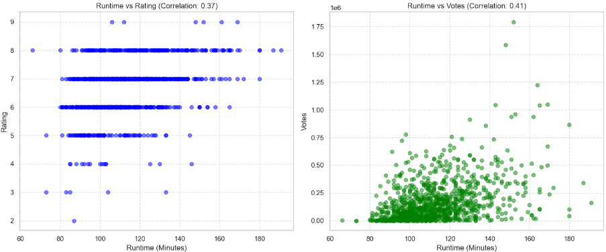
Q6) Does the length of the movie have any impact on its rating or votes ?

Slide 12
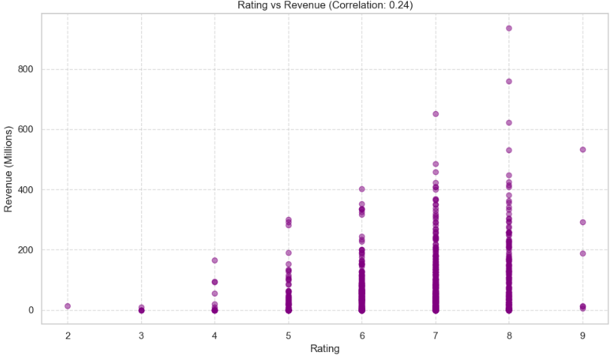
Q7) What is the impact of movie ratings on revenue?

Slide 13
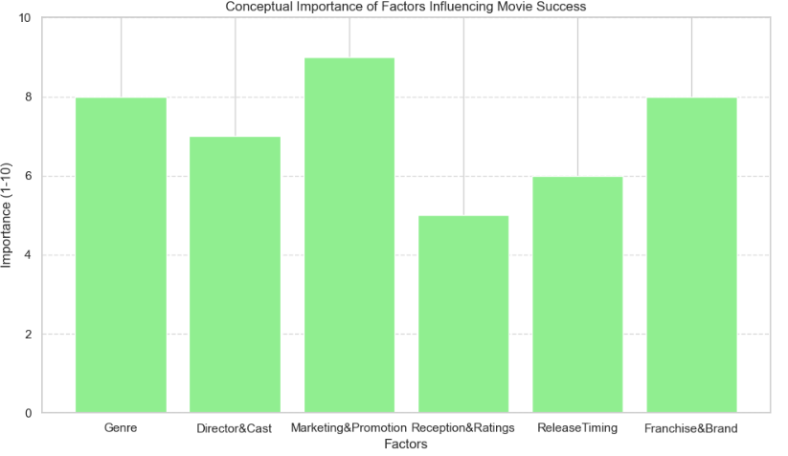
Q8) What factors most influence movie success?

Slide 14




Actionable Insights
Genre Popularity
The most common genres are Drama, Action, and Comedy. Less common genres include Western, Musical, and War.
Top Directors by Average Rating:
Directors like Nitesh Tiwari, Christopher Nolan, and Olivier Nakache have high average ratings for their movies, indicating strong audience appreciation.
Rating-Revenue Relationship
The correlation between ratings and revenue is approximately 0.22, suggesting a moderate positive relationship; higher-rated movies tend to generate more revenue.

Slide 15
Summary
Optimal Runtime for Different Genres in Terms of Audience Satisfaction:
Influence of Critical Reviews and Audience Ratings on Box Office Performance:
Data Analysis: Movies were categorized by primary genre and runtime intervals to analyze average IMDb ratings. The findings showed that certain genres have higher average ratings within specific runtime ranges.
Chart Visualization: The chart illustrated that audience satisfaction varies by genre and runtime. For example, action movies tend to have higher ratings in the 120-180-minute range, while shorter runtimes (<90 minutes) generally correlate with lower ratings across most genres.
Correlation Analysis: The analysis showed that there is a positive correlation between IMDb ratings and box office revenue, but it is relatively weak (0.218). The number of votes, representing audience engagement, has a stronger correlation with revenue (0.640). Metascore, which reflects critical reviews, has the weakest correlation with revenue (0.142).
Scatter Plots: Visualizations confirmed these relationships, indicating that while critical reviews do have some influence, audience engagement (as indicated by votes) is a more significant predictor of box office success.

Slide 16
THANK YOU

